Slide 1
Hashing Exercises

Slide 2
Hash Function
A good hash function should be:
Repeatable
Fast to compute (don’t want to add complexity)
Minimizes Collisions
Utilizes the whole range of the table

Slide 3
Hash functions
Repeatable
Fast to compute (don’t want to add complexity)
Minimizes Collisions
Utilizes the whole range of the table
Table Size: 100,000
Hashing A#
int hash=A[3];

Slide 4
Hash functions
Repeatable
Fast to compute (don’t want to add complexity)
Minimizes Collisions
Utilizes the whole range of the table
Table Size: 100,000
Hashing A#
int hash=0;
for(int i=1; i<9; i++)
hash+=A[i];

Slide 5
Hash functions
Repeatable
Fast to compute (don’t want to add complexity)
Minimizes Collisions
Utilizes the whole range of the table
Table Size: 100,000
Hashing A#
int hash=rand()%100,000;

Slide 6
Hash functions
Repeatable
Fast to compute (don’t want to add complexity)
Minimizes Collisions
Utilizes the whole range of the table
Table Size: 100,000
Hashing A#
int hash=0;
for(int i=1; i<9; i++)
hash=hash*128+A[i];

Slide 7
Hash functions
Repeatable
Fast to compute (don’t want to add complexity)
Minimizes Collisions
Utilizes the whole range of the table
Table Size: 100,000
Hashing A#
int hash=0;
for(int i=1; i<9; i++)
hash=hash<<7+A[i];

Slide 8
Exercises
Table Size 15
Hash- mod 15
Insert 16, 7, 28, 31, 67, 28, 29, 73, 99, 43, 218
Linear Probe
Quadratic Probe
Chaining
Double hash – %13 + 1

Slide 9
Exercise 1
0
1
2
3
4
5
6
7
8
9
10
11
12
13
14
Linear probe
Insert 16, 7, 28, 31, 67, 28, 29, 73, 99, 43, 218
How many probes?

Slide 10
Exercise 1
0 | 73
1 | 16
2 | 31
3 | 43
4
5
6
7 | 7
8 | 67
9 | 99
10 | 218
11
12
13 | 28
14 | 29
Linear probe
Insert 16, 7, 28, 31, 67, 28, 29, 73, 99, 43, 218
How many probes?
22

Slide 11
Exercise 2
0
1
2
3
4
5
6
7
8
9
10
11
12
13
14
Quadratic probe
Insert 16, 7, 28, 31, 67, 28, 29, 73, 99, 43, 218
How many probes?

Slide 12
Exercise 2
0
1 | 16
2 | 31
3 245 260 275
4 | 73
5
6
7 | 7
8 | 67
9 | 99
10
11
12 | 218
13 | 28
14 | 29
Quadratic probe
Insert 16, 7, 28, 31, 67, 28, 29, 73, 99, 43, 218
How many probes?
18
43 couldn’t insert (I went to 40)

Slide 13
Exercise 3
0
1
2
3
4
5
6
7
8
9
10
11
12
13
14
Chaining
Insert 16, 7, 28, 31, 67, 28, 29, 73, 99, 43, 218
How many probes?

Slide 14
Exercise 3
0
1 | 16->31
2
3
4
5
6
7 | 7->67
8 | 8
9 | 99
10
11
12
13 | 28->73->43
14 | 29
Chaining
Insert 16, 7, 28, 31, 67, 28, 29, 73, 99, 43, 218
How many probes?
16

Slide 15
Exercise 4
0
1
2
3
4
5
6
7
8
9
10
11
12
13
14
Double hash %13 + 1
Insert 16, 7, 28, 31, 67, 28, 29, 73, 99, 43, 218
How many probes?

Slide 16
Exercise 4
0
1 | 16
2
3 | 43
4 | 31
5
6
7 | 7
8 | 218
9 | 99
10 | 67
11
12
13 | 28
14 | 29
Double hash %13 + 1
Insert 16, 7, 28, 31, 67, 28, 29, 73, 99, 43, 218
How many probes?
15
Cannot insert 73 because 9*5 = 15*3

Slide 17
Clustering
Primary Clustering- Didn’t initially hash to same location, but had to compete for successive
Secondary Clustering- Hashed to the same place, and continued competing
Non-Clustering

Slide 18
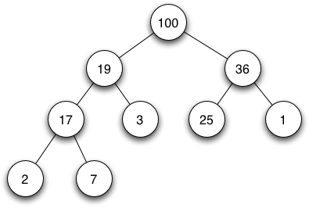
Complete Heap
Insert 10, 105, 18, 9

Slide 19
Complete Heap
0
1
2
3
4
5
6
7
8
9
10
11
12
13
14
Put it in the array

Slide 20
Complete Heap
0 | 100
1 | 19
2 | 36
3 | 17
4 | 3
5 | 25
6 | 1
7 | 2
8 | 7
9
10
11
12
13
14
Insert 10, 105, 18, 9

Slide 21
Complete Heap
Delete largest, then delete again for next largest

Slide 22
Complete Heap
0 | 100
1 | 19
2 | 36
3 | 17
4 | 3
5 | 25
6 | 1
7 | 2
8 | 7
9
10
11
12
13
14
Delete largest, then delete again for next largest

Slide 23
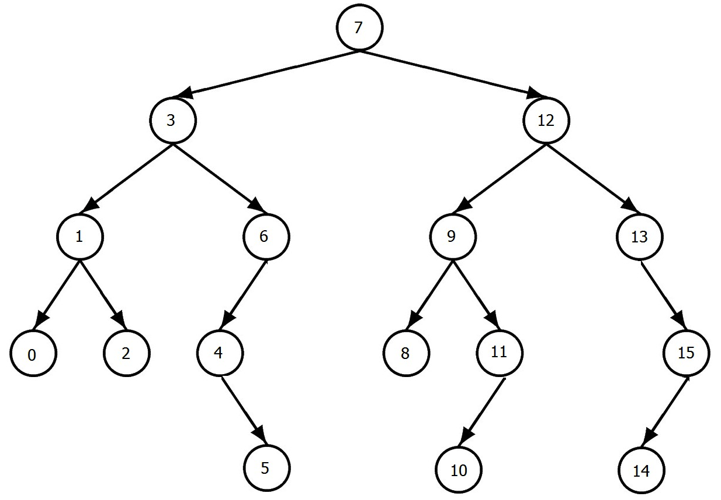
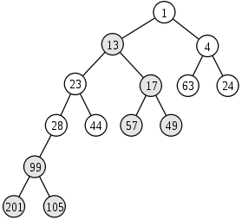
Leftist Heap
Are these leftist heaps?

Slide 24
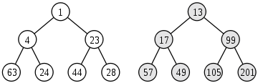
Leftist Heap
Are these leftist heaps?

Slide 25
Leftist Heap
Merge

Slide 26
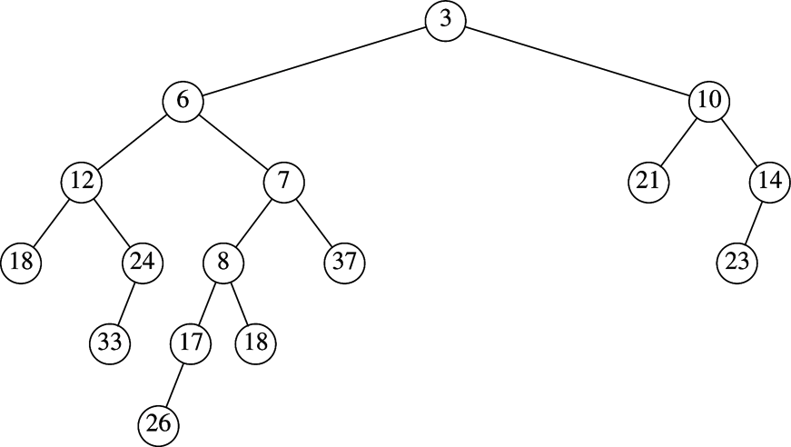
Leftist Heap
Insert 3

Slide 27
Leftist Heap
Insert 4

Slide 28
Leftist Heap
Delete

Slide 29
Skew Heap
Merge

Slide 30
Skew Heap
Insert 4

Slide 31
Skew Heap
Delete

Slide 32
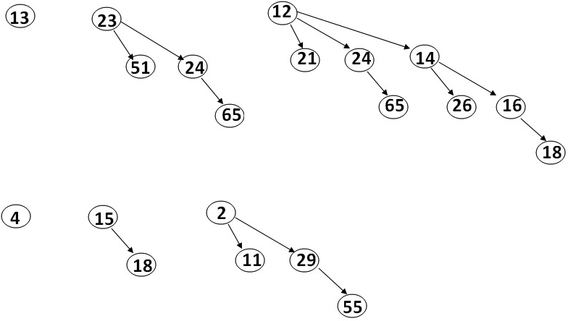
Binomial Queue
Merge

Slide 33
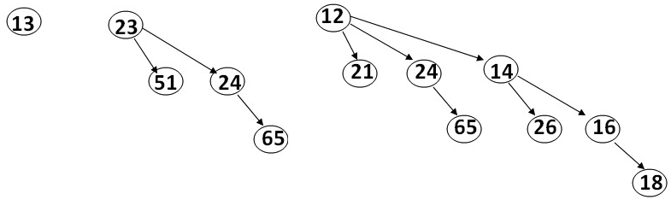
Binomial Queue
Insert 12, 11, 28, 33

Slide 34
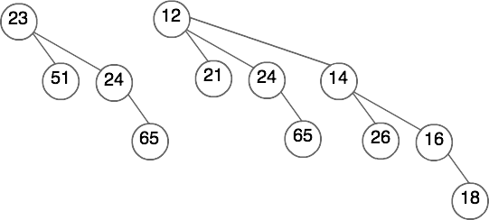
Binomial Queue
Delete

Slide 35
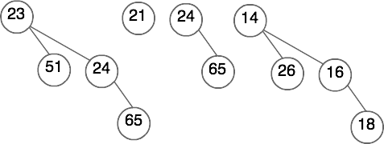
Binomial Queue
Delete

Slide 36
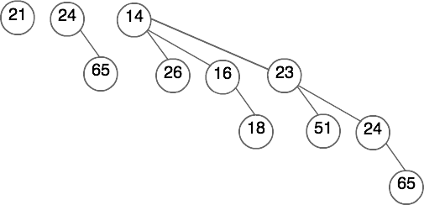
Binomial Queue
Delete

Slide 37
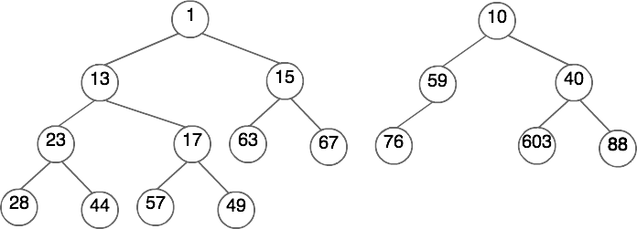
Leftist Heap
Merge

Slide 38
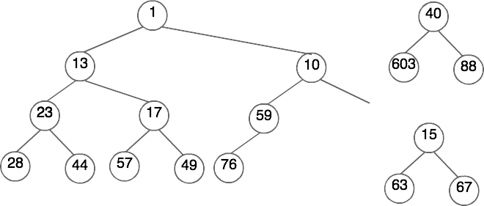
Leftist Heap
Merge

Slide 39
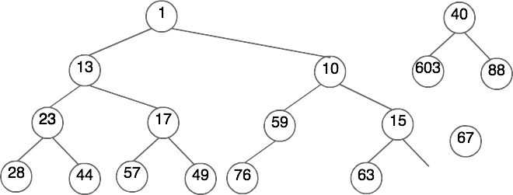
Leftist Heap
Merge

Slide 40
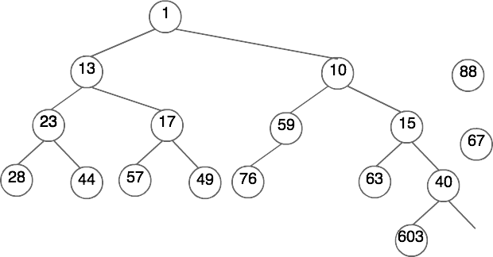
Leftist Heap
Merge

Slide 41
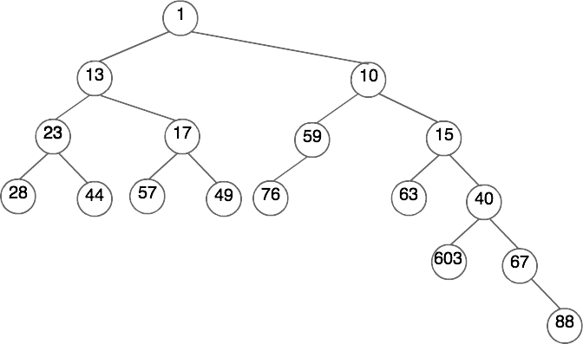
Leftist Heap
Merge

Slide 42
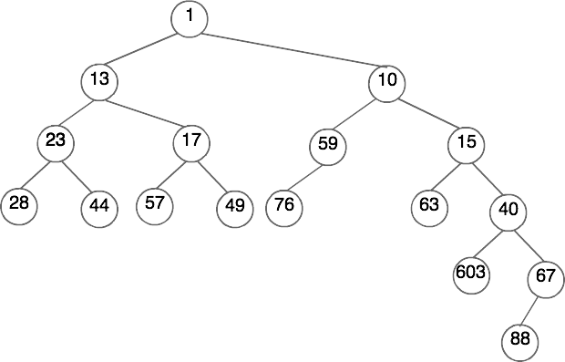
Leftist Heap
Merge

Slide 43
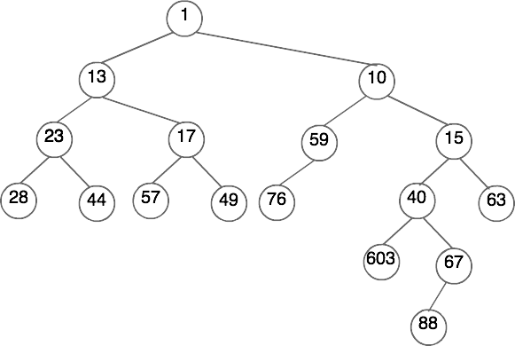
Leftist Heap
Merge

Slide 44
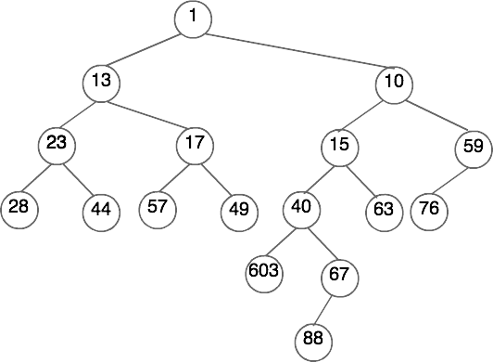
Leftist Heap
Merge

Slide 45
Leftist Heap
Merge

Slide 46
Skew Heap
Merge

Slide 47
Skew Heap
Merge

Slide 48
Skew Heap
Merge

Slide 49
Skew Heap
Merge

Slide 50
Skew Heap
Merge

Slide 51
Skew Heap
Merge

Slide 52
Skew Heap
Merge

Slide 53
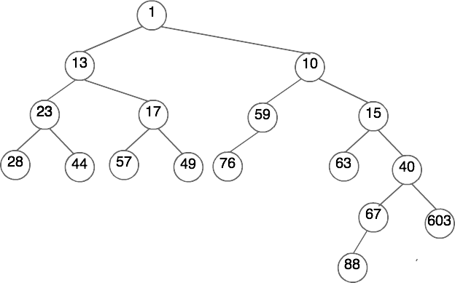
Skew Heap
Merge

Slide 54
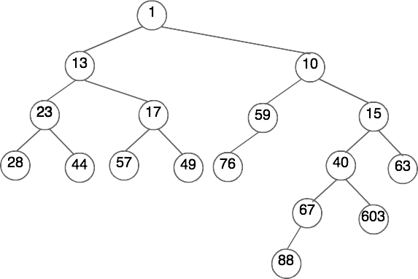
Skew Heap
Merge

Slide 55
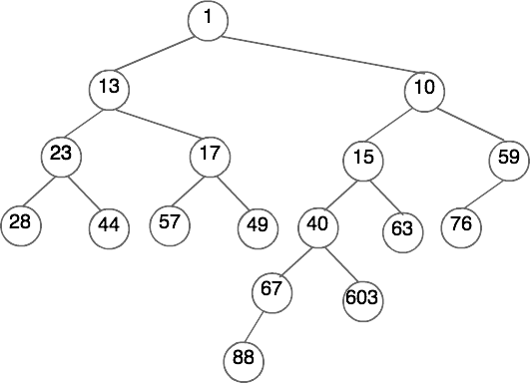
Skew Heap
Merge

Slide 56
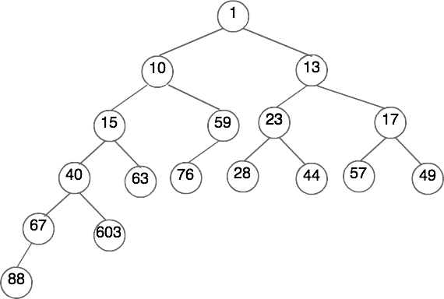
Skew Heap
Merge

Slide 57
Complete Heap
0 | 100
1 | 89
2 | 36
3 | 17
4 | 67
5 | 35
6 | 19
7 | 4
8 | 7
9 | 43
10 | 59
11 | 28
12 | 23
13 | 21
14
Is this a complete max heap?

